Slide 1

Anomaly Detection in Time Series for Space Applications
Developed by: David Huergo Perea
Supervised by: Juan Antonio Hernández

Slide 2
Contents
Time series
How to detect anomalies?
Anomaly detection: complete procedure
Preprocessing: noise reduction and decomposition
Spectral residual transformation
Computational time: Fortran vs Python
Space applications: NASA’s benchmark
Transformers and detectors

Slide 3
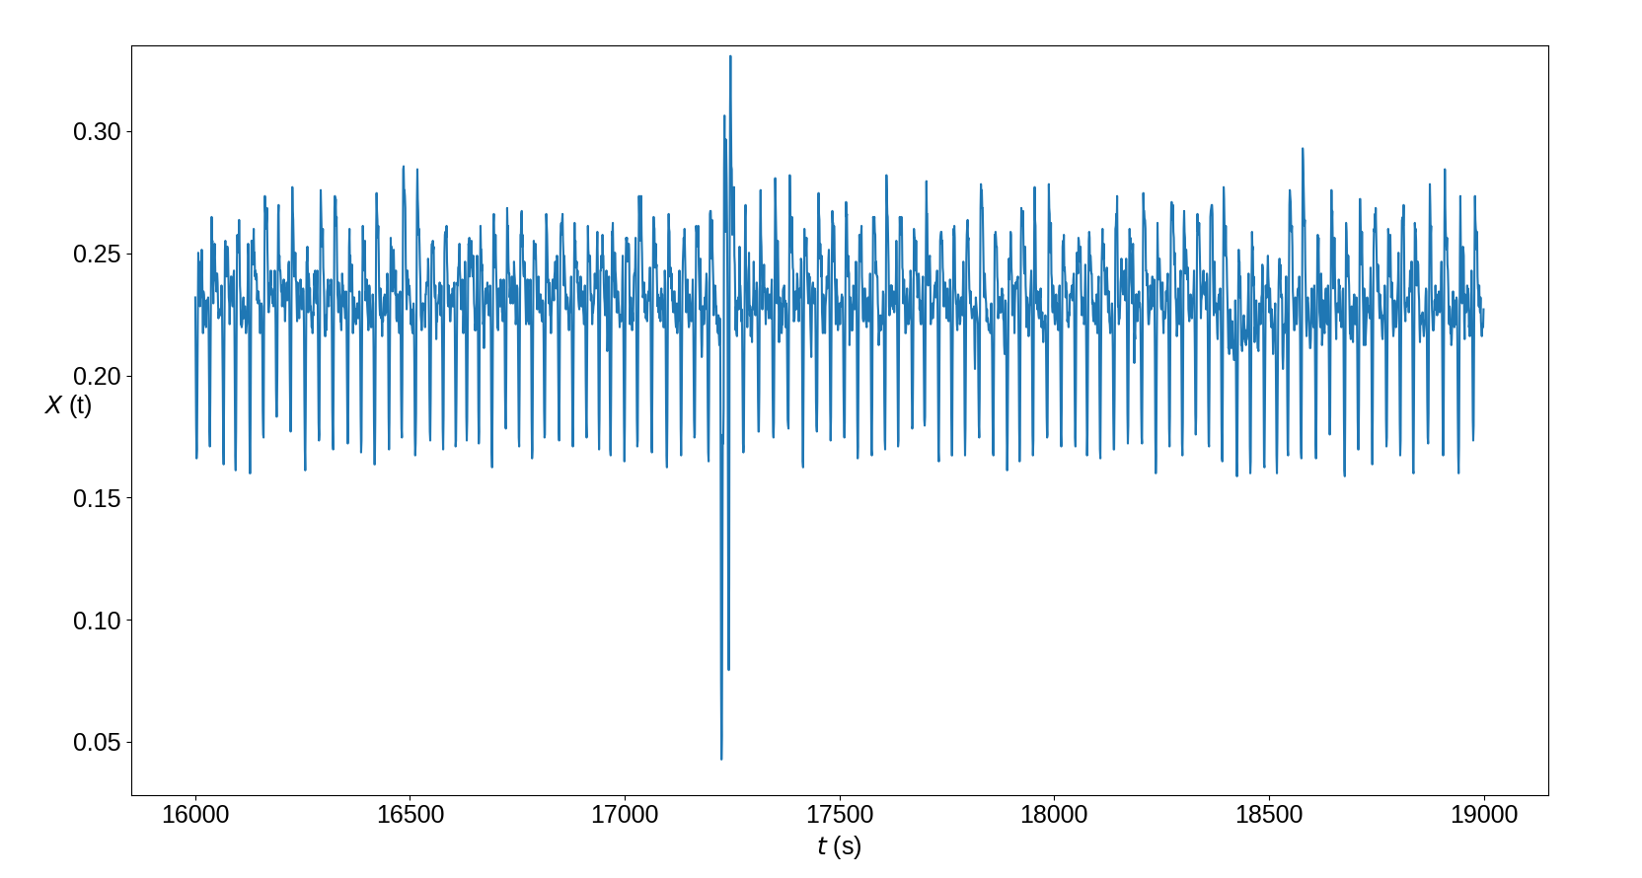
1. Time series
A time series is a set of points that defines a function of the time.
Each one of these points have a timestamp, which represents the moment when a certain variable was measured.
An anomaly is any deviation from the expected behaviour of the time series!

Slide 4

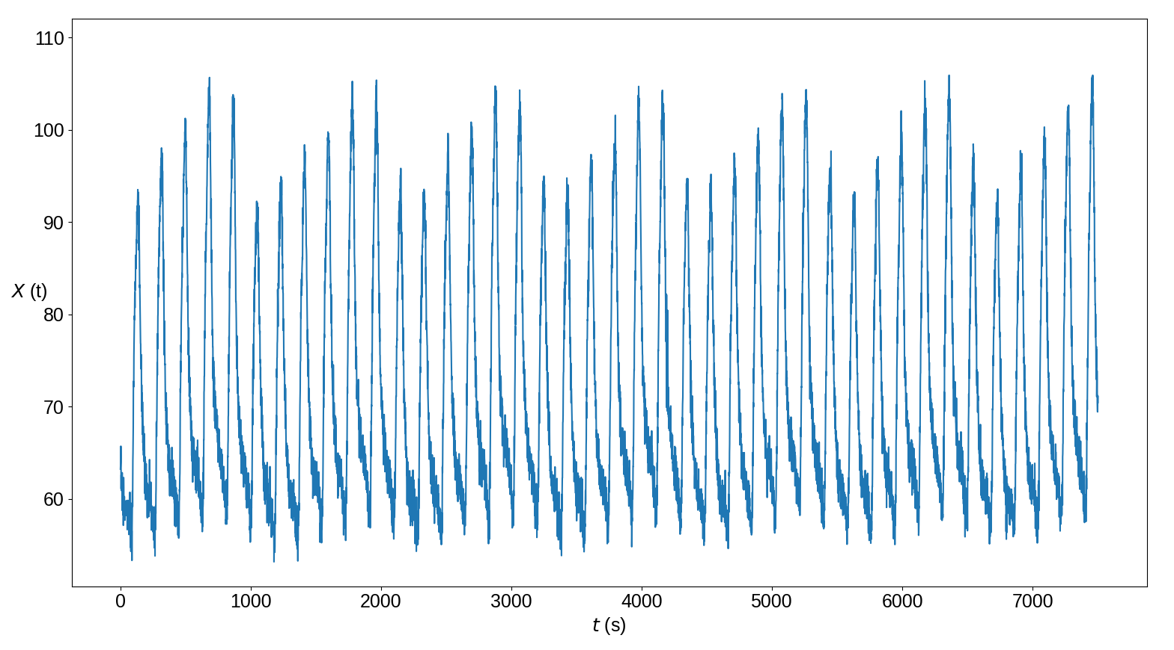
2. How to detect anomalies?
Anomaly detection
Detectors and transformers
Pre-processing
Spectral residual

Slide 5

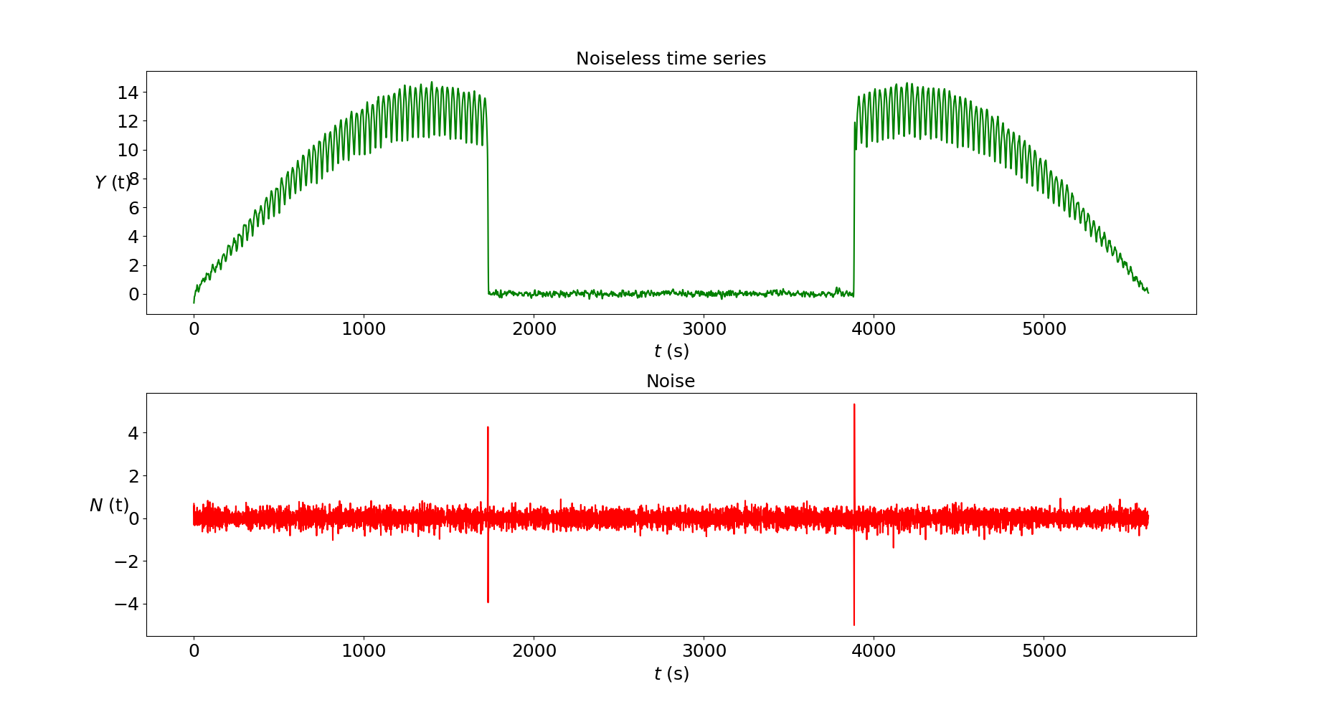
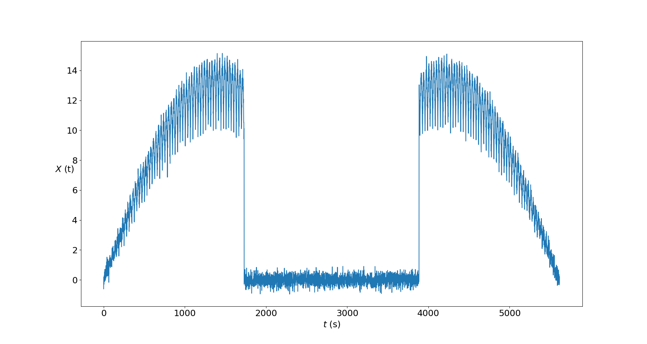

2.1. Preprocessing: Noise reduction
Mean Value Filter
$${\hat{X}}_{j}=\frac{1}{t_{j+1}−t_{j−1}}\int_{t_{j−1}}^{t_{j+1}}{X\left(t\right) dt}=\frac{X_{j−1}+2αX_{j}+X_{j+1}}{2(α+1)}$$

Slide 6
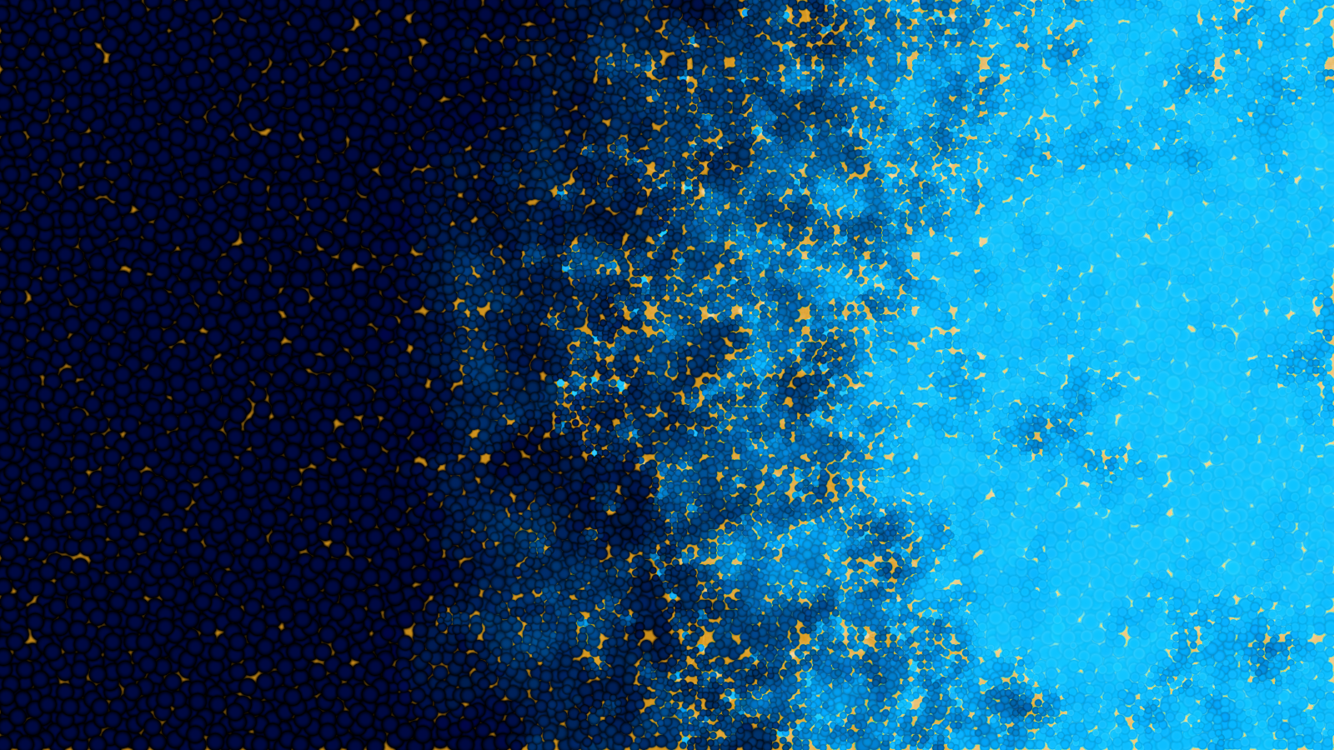
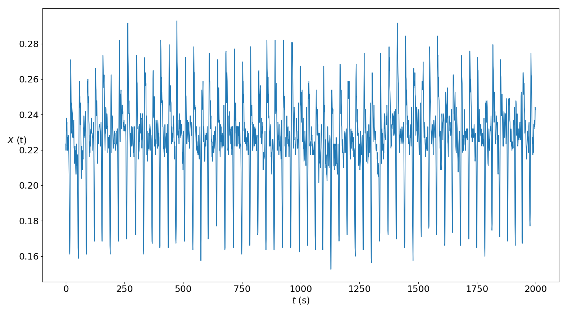

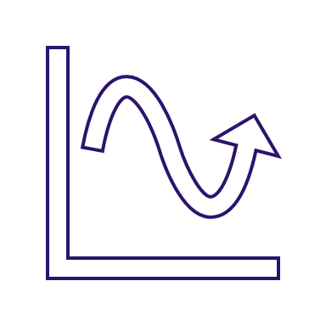
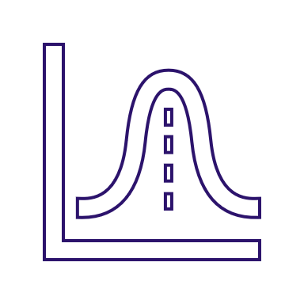
2.1. Preprocessing: Time Series Decomposition
Trend
Seasonal
Residuals

Slide 7
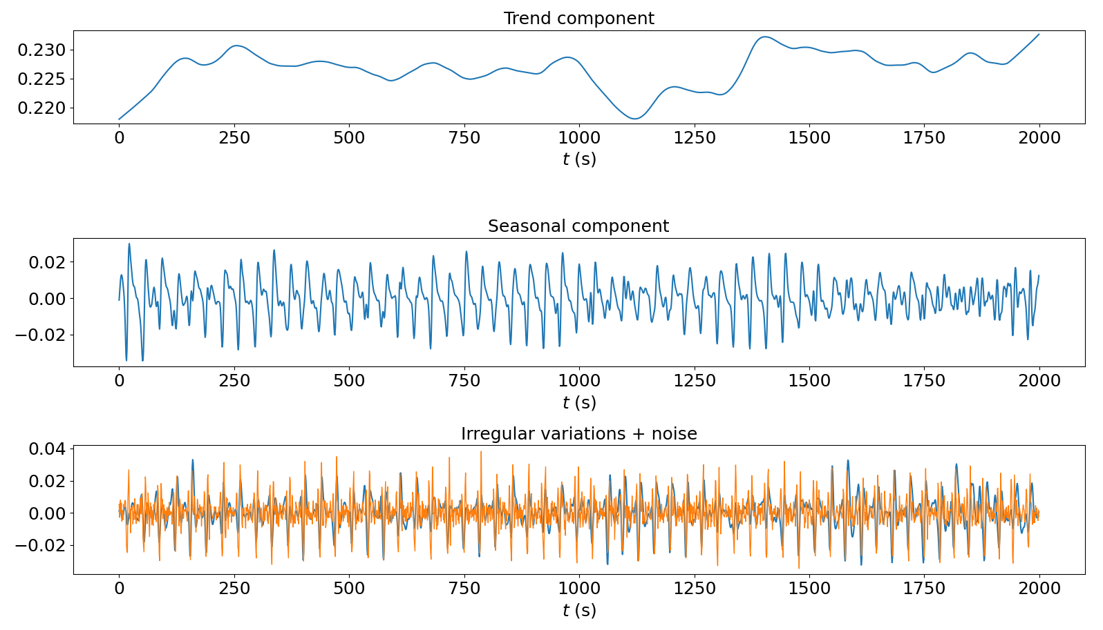
2.1. Preprocessing: Time Series Decomposition
STL
Seasonal Trend decomposition using Loess

Slide 8
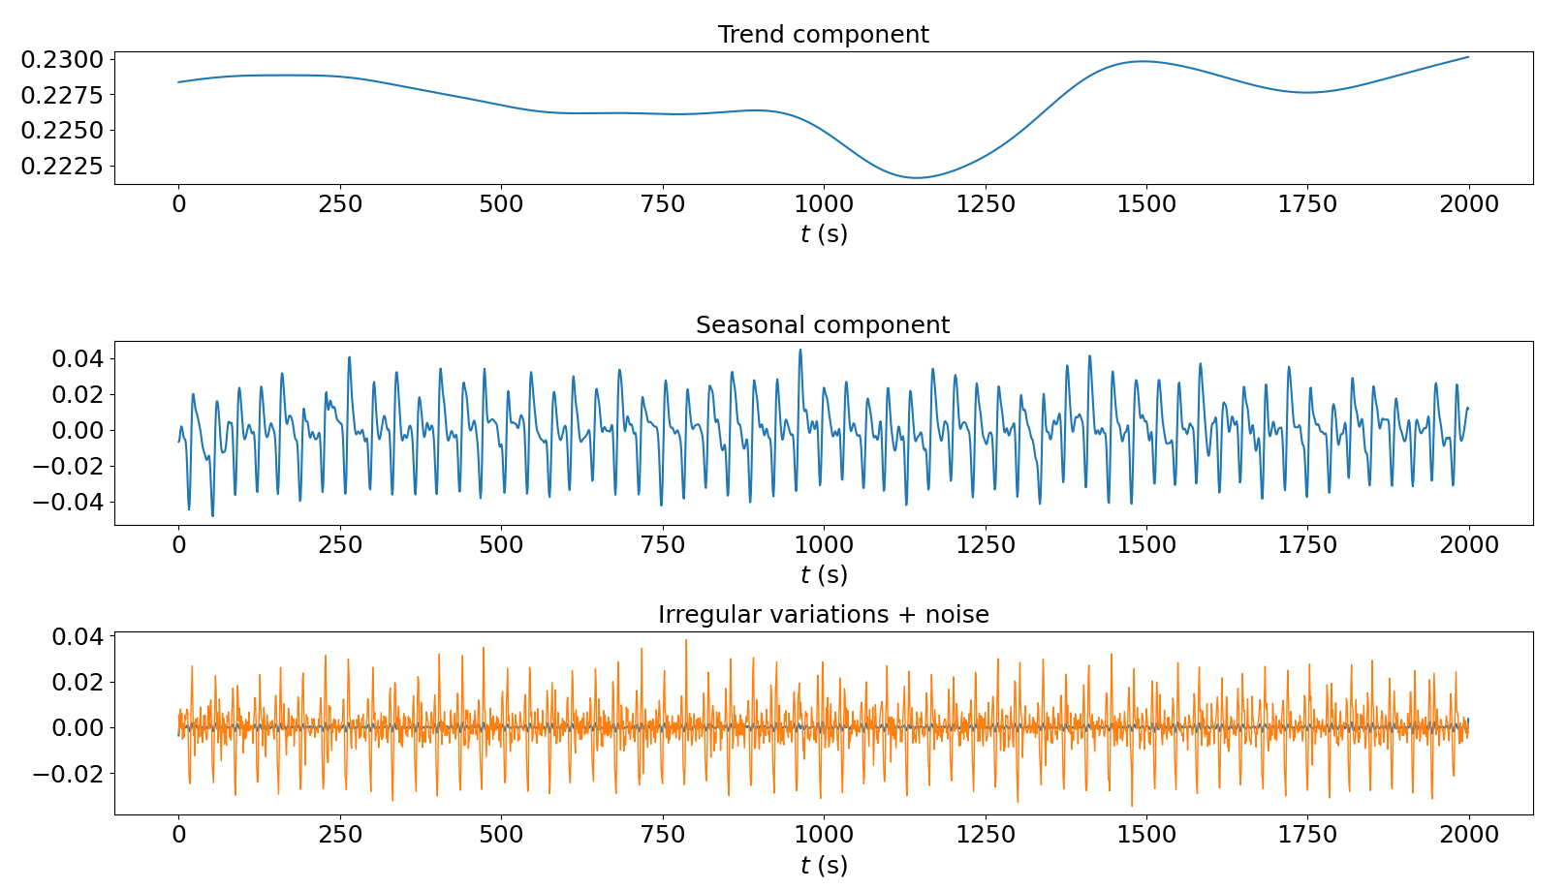
2.1. Preprocessing: Time Series Decomposition
MVD
Mean
Value Decomposition

Slide 9

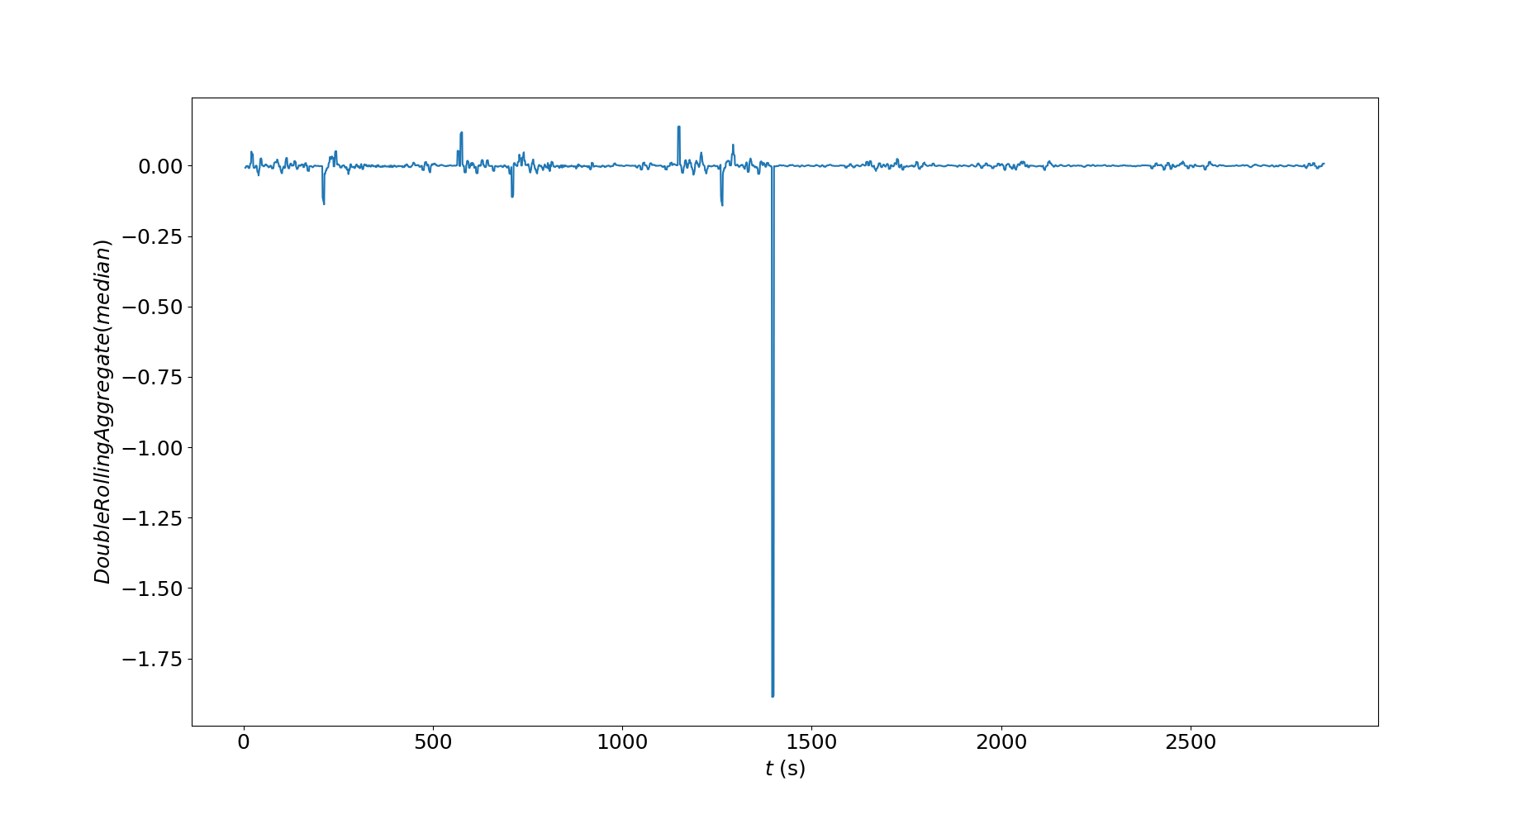
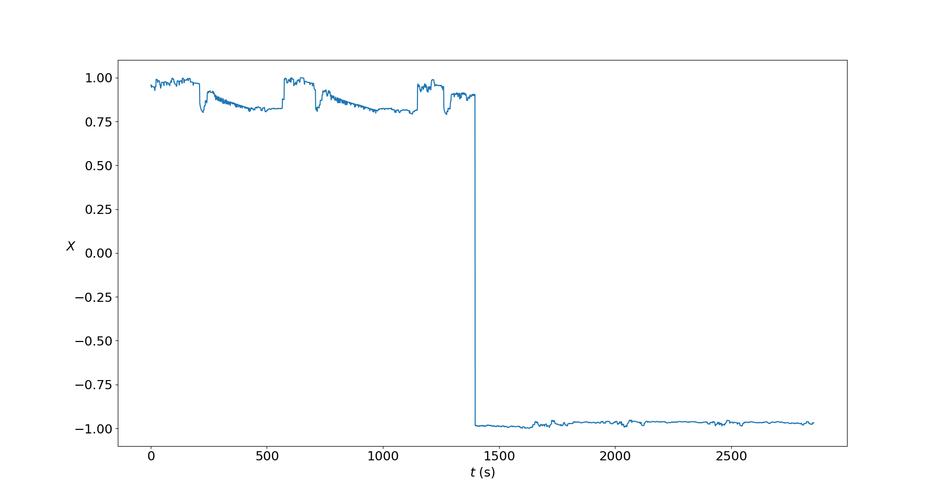


2.2. Transformers and detectors
Transformers: change the domain of the time series to highlight anomalies.
Detectors: threshold of $±3σ$ to detect the anomalies.
Python
ADTK
Anomaly Detection ToolKit

Slide 10

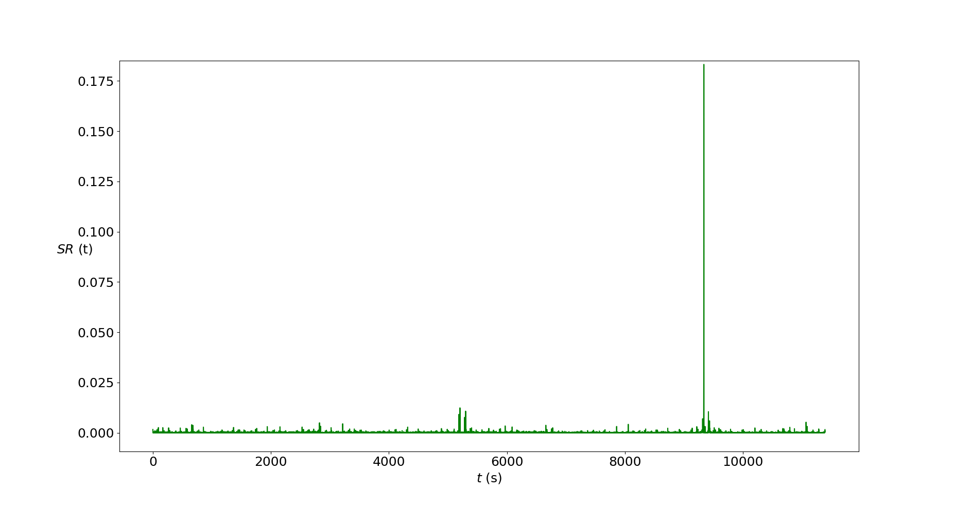
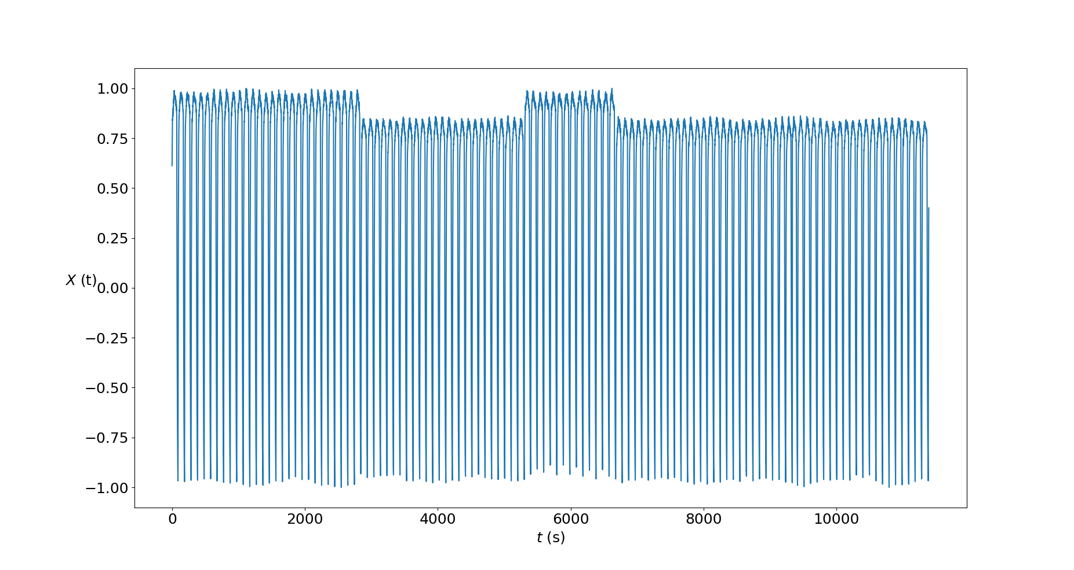
2.3. Spectral Residual Transformation
Transformation to extract the residuals in the spectral domain.
This method highlights anomalies, back in the time domain.

Slide 11
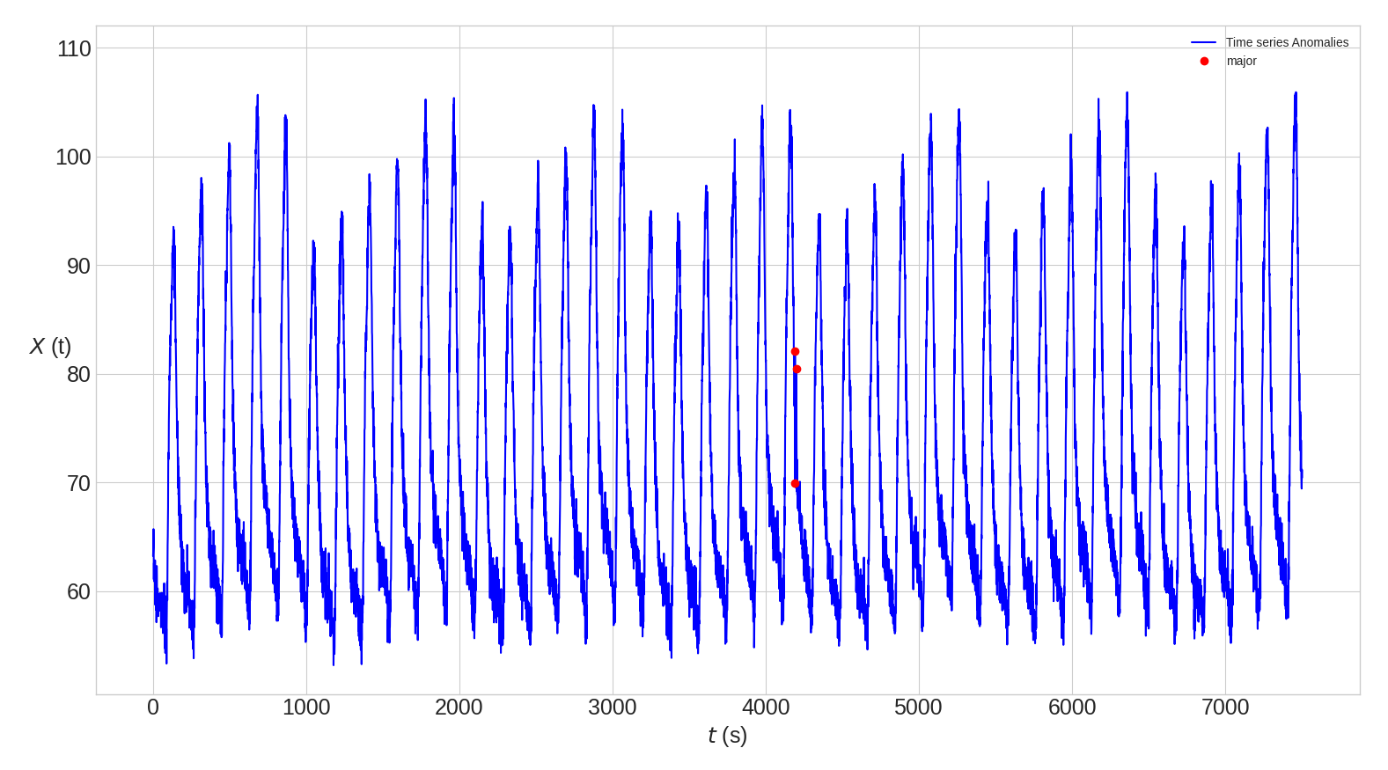
3. Anomaly detection: complete procedure
Noise reduction
STL
MVD
SR
Transformers
Detectors

Slide 12

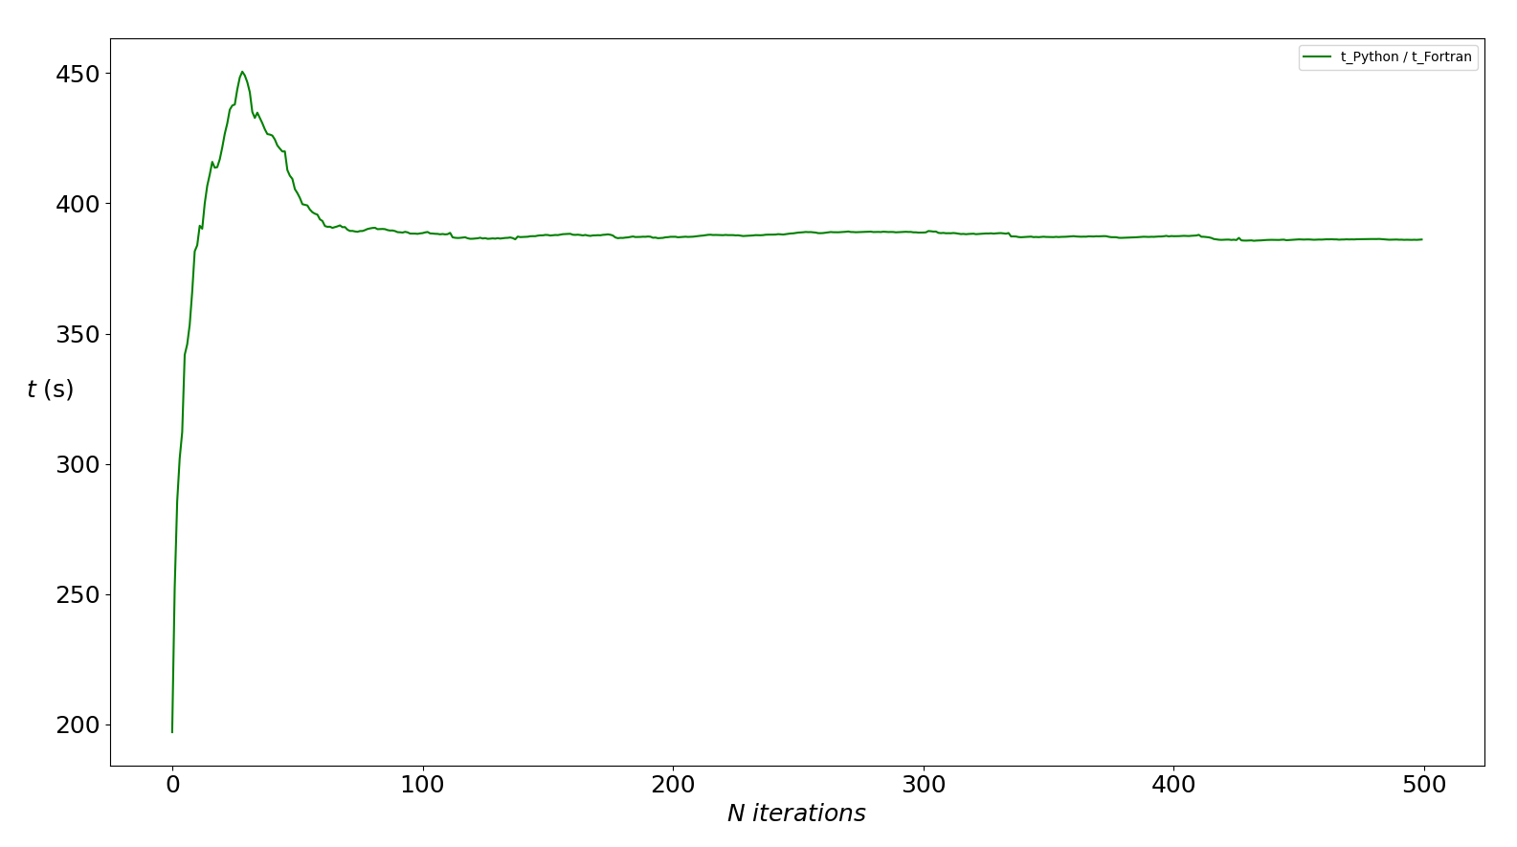
4. Computational time
The complete procedure is computationally expensive in Python.
Fortran pre-compiled code may improve the speed almost 400 times.
t_py/t_f
Fortran to Python wrapper
Release Fortran to Python Wrapper v_1.0 · mramagu/Fortran-to-Python-Wrapper · GitHub

Slide 13




5. Space applications: NASA’s database
Nowadays, every space misión requires several experts for monitoring time series. Anomalies are detected manually.
Computational analysis of time series may be used in space missions to reduce time and costs in several phases!!
Only some thresholds are used automatically to raise alarms.
The new procedure has been tested with 81 time series from NASA’s database: almost 90% of perfect anomaly detection.
Github repository
GitHub - Dhueper/TimeSeries-AnomalyDetection: Anomaly detection in time series for space applications

Slide 14
References
[1] E. Keogh, T. Dutta Roy, U. Naik, A. Agrawal, Multi-dataset time-series anomaly detection competition, SIGKDD 2021 (2021). URL https://compete.hexagon-ml.com/practice/competition/39/
[2] K. Hundman, Anomaly detection in time series data using LSTMs and automatic thresholding (2020). URL https://github.com/khundman/telemanom
[3] D. A. Pal, D. P. Prakash, Practical time series analysis: master time series data processing, visualization, and modeling using Python, Packt Publishing, Birmingham, 2017.
[4] R. B. Cleveland, W. S. Cleveland, J. E. McRae, I. Terpenning, STL: A seasonal-tren decomposition procedure based on loess, Journal of Official Statistics 6 (1990) 3–73.
[5] Arundo Analytics, Inc., Anomaly Detection Toolkit (ADTK) (2020). URL https://adtk.readthedocs.io/en/stable/index.html
[6] K. Hundman, V. Constantinou, C. Laporte, I. Colwell, T. Soderstrom, Detecting spacecraft anomalies using LSTMs and nonparametric dynamic thresholding, In KDD ’18: The 24th ACM SIGKDD International Conference on Knowledge Discovery Data Mining, August 19–23, 2018, London, United Kingdom (2018) 9. URL https://doi.org/10.1145/3219819.3219845
[7] H. Ren, B. Xu, Y. Wang, C. Yi, C. Huang, X. Kou, T. Xing, M. Yang, Y. Tong, Q. Zhang, Time-series anomaly detection service at microsof, In The 25th ACM SIGKDD Conference on Knowledge Discovery and Data Mining (KDD ’19), August 4–8, 2019, Anchorage, AK, USA. ACM, New York, NY, USA (2019) 9. URL https://doi.org/10.1145/3292500.3330680

Slide 15
Thank you!

